Slide 1
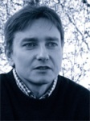
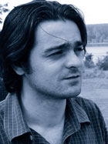
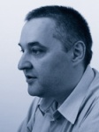
Institute of Physics Belgrade
Scientific Computing Laboratory
www.scl.rs

Slide 3
High Performance Computing (HPC)
One of 5 research and development priorities in EU
Time dependant operative definition of HPC: top500.org

Slide 4
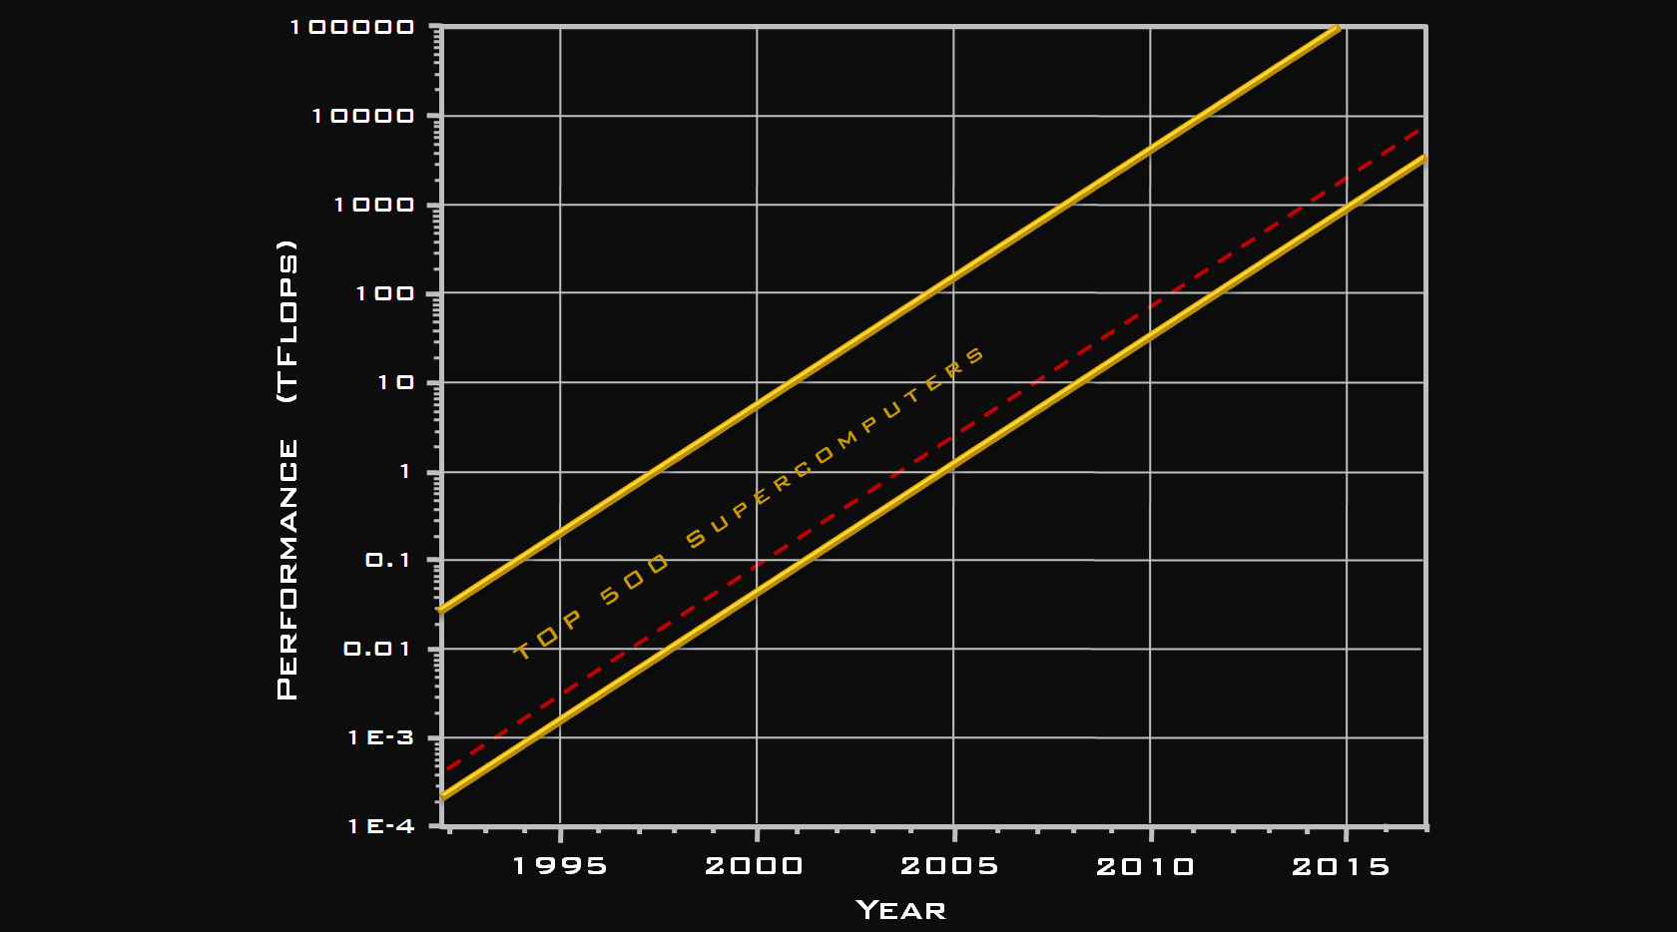

Slide 5
Two approaches to HPC
GRID
Pan-European Infrastructure (EGEE) ~100000 CPU-s
~100 PB
Supercomputing
Partnership for Advanced Computing in Europe (PRACE) Tier 0 Installations (5) Tier 1 Installations (regional/national) Tier 2 Installations (institutions)

Slide 6
Uses of HPC
Basic science
Modeling of complex systems
Classical and quantum ab initio simulations
Applied research
Engineering new materials
Meteorology, seismology, environment
Commercial applications
Cryptography
Distributed data repositories
Video rendering

Slide 7
GRID @ SCL
AEGIS01-PHY-SCL grid site
712 64-bit CPU-s
800 GB RAM
30 TB storage
AEGIS07-PHY-ATLAS grid site
128 32-bit CPU-s
96 GB RAM
CORE GRID SERVICES
40 64-bit CPU-s
70 GB RAM
CONNECTIVITY
INTERNAL: 14 Gbps Stack, 6 Gbps storage, 1 Gbps WNs
EXTERNAL: 1 Gbps optic connection

Slide 8
SCL @ GRID
Pan-European infrastructure (EGEE)
Most efficient site
~3% of all resource usage
Regional infrastructure (SEE-GRID)
Regional infrastructure coordinator
~50% of all resource usage
National infrastructure (AEGIS)
National coordinator
Only production GRID sites in Serbia
Learning with ATLAS@CERN
Developing e-Learning tools

